Slide 1
Course Title: Engineering Chemistry-1
Course Code: CHE109
(Chapter 6)
Dr. Joyanta Kumar Saha
Associate Professor
Department of Chemistry
Jagannath University

Slide 2
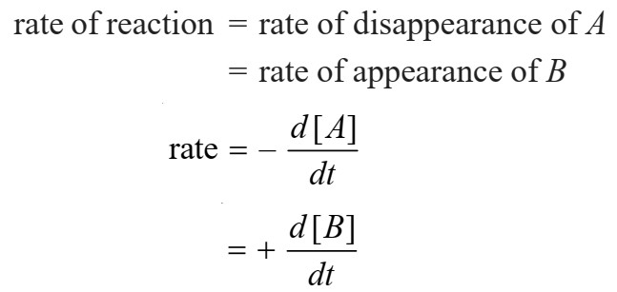
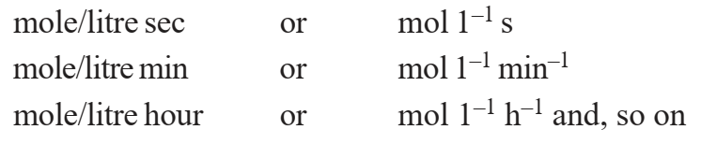
Chemical Kinetics
The study of Chemical Kinetics includes : (1) The rate of the reactions and rate laws. (2) The factors as temperature, pressure, concentration and catalyst, that influence the rate of a reaction. (3) The mechanism or the sequence of steps by which a reaction occurs.
REACTION RATE The rate of reactions is defined as the change in concentration of any of reactant or products per unit time. Let us consider a simple reaction A ⎯⎯→ B
Units of rate:

Slide 3
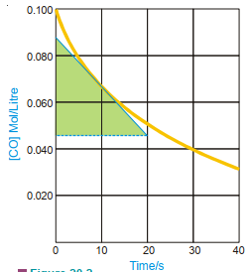
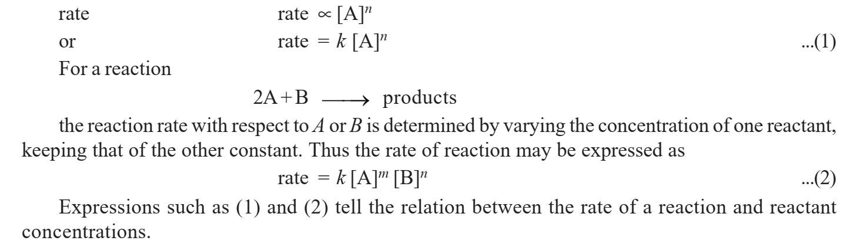
Instantaneous Rate of Reaction: at any time the instantaneous rate is equal to the slope of a straight line drawn tangent to the curve at that time.
RATE LAWS: the rate of a reaction is directly proportional to the reactant concentrations, each concentration being raised to some power.

Slide 4
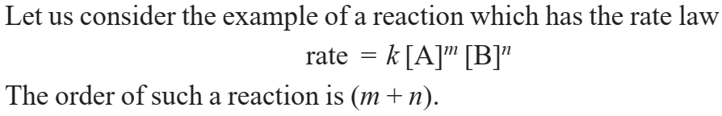
ORDER OF A REACTION: The order of a reaction is defined as the sum of the powers of concentrations in the rate law.
ZERO ORDER REACTION: A zero order reaction is one whose rate is independent of concentration. For example, the rate law for the reaction NO₂ + CO ⎯⎯→ NO + CO₂ at 200° C is rate = k [NO₂]² The reaction is zeroth order with respect to CO. The reaction is second order with respect to [NO₂]. The overall reaction order is 2 + 0 = 2.
MOLECULARITY OF A REACTION: Chemical reactions may be classed into two types : (a) Elementary reactions (b) Complex reactions An elementary reaction is a simple reaction which occurs in a single step. A complex reaction is that which occurs in two or more steps.

Slide 5
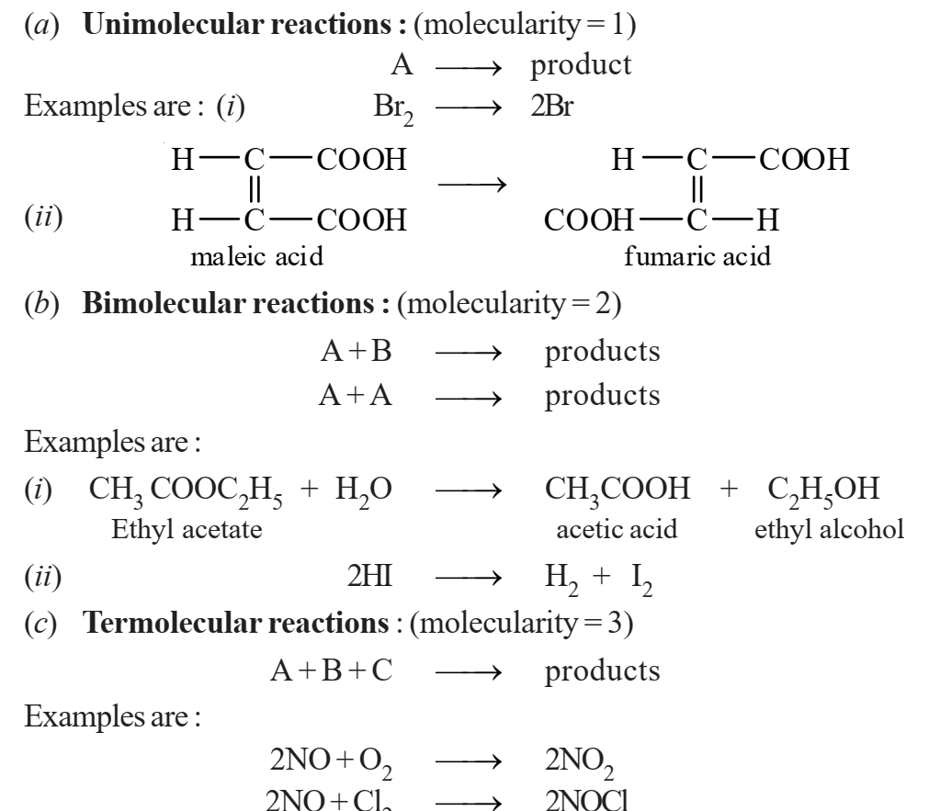
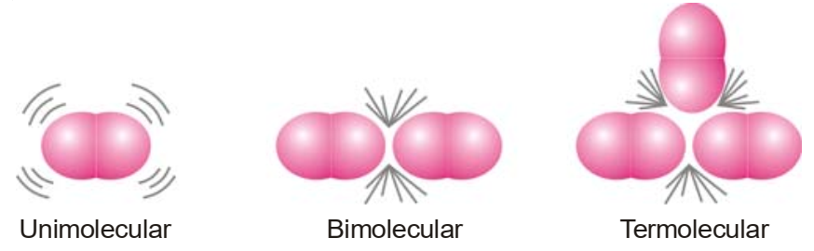
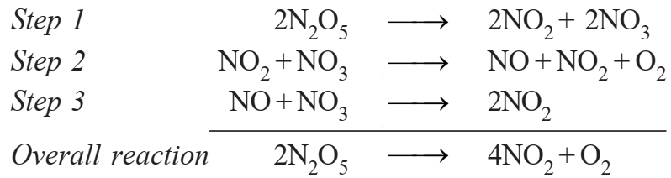
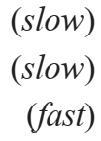
Molecularity of an Elementary Reaction The number of reactant molecules involved in a reaction.
Molecularity of a Complex Reaction
The number of molecules or atoms taking part in the rate-determining step.
Step 2 in the above mechanism is rate-determining and has molecularity ‘2’

Slide 6
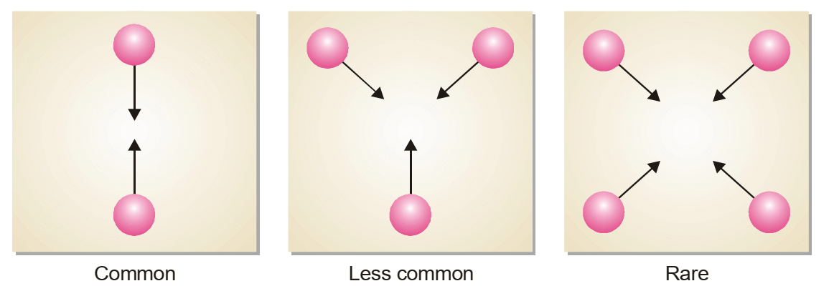
Why High Molecularity Reactions are Rare ?
According to kinetic molecular theory, the rate of a chemical reaction is proportional to the number of collisions taking place between the reacting molecules. The chances of simultaneous collision of reacting molecules will go on decreasing with increase in number of molecules. Thus the possibility of three molecules colliding together is much less than in case of bimolecular collision. For a reaction of molecularity 4, the four molecules must come closed and collide with one another at the same time. The possibility of their doing so is much less than even in the case of termolecular reaction.

Slide 7
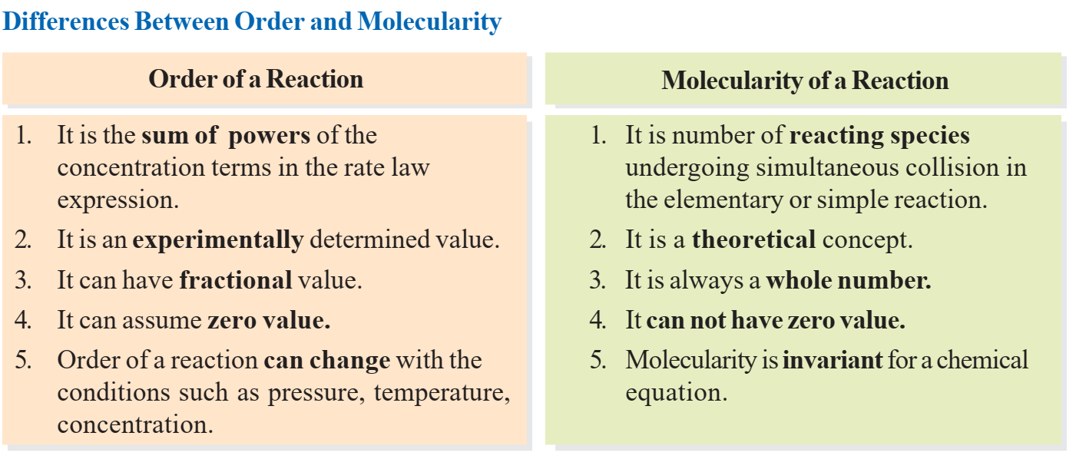

Slide 8
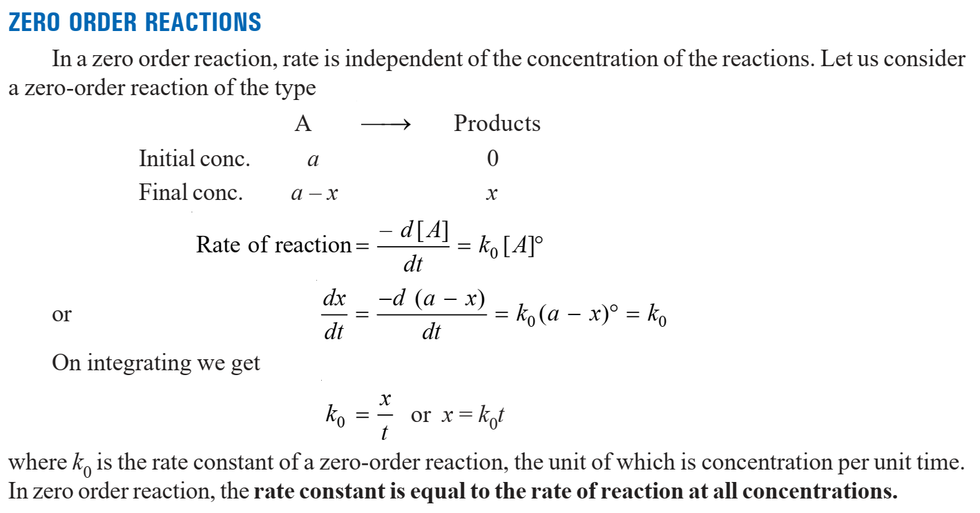

Slide 9
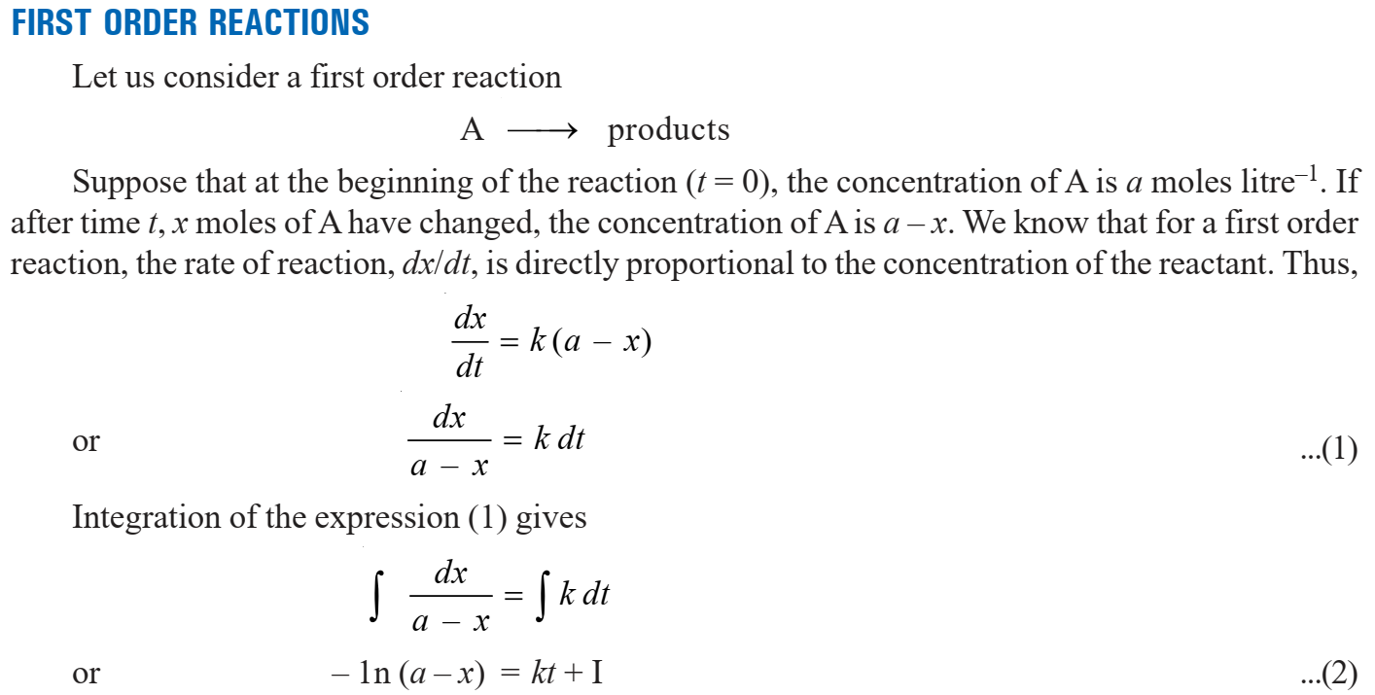

Slide 10
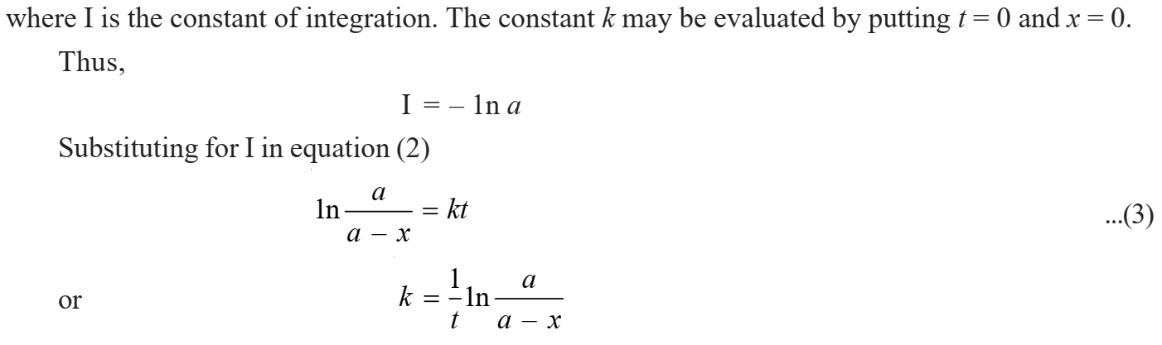
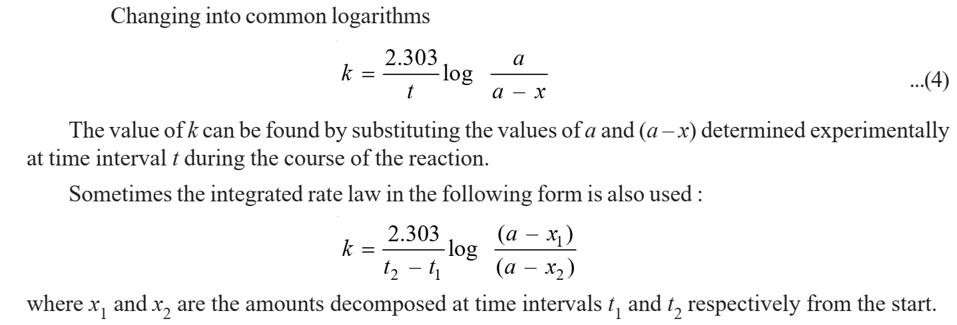

Slide 11
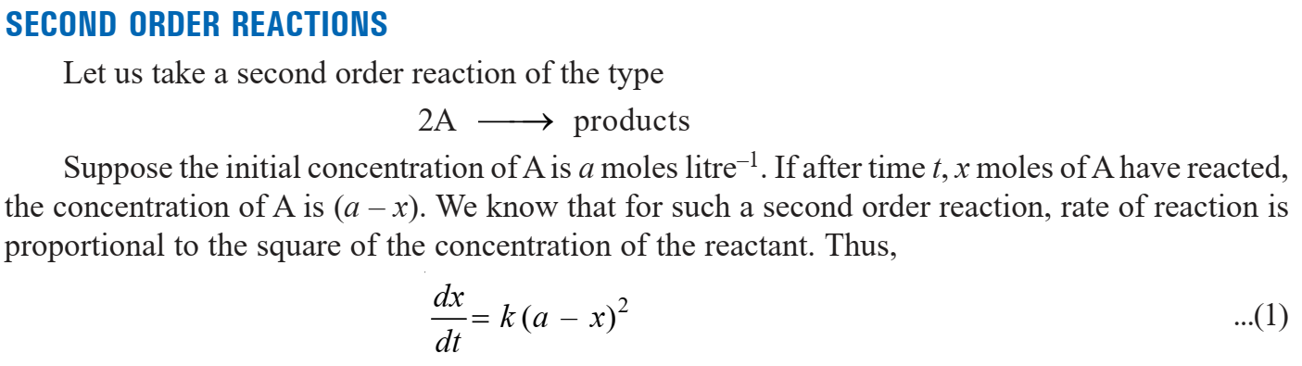
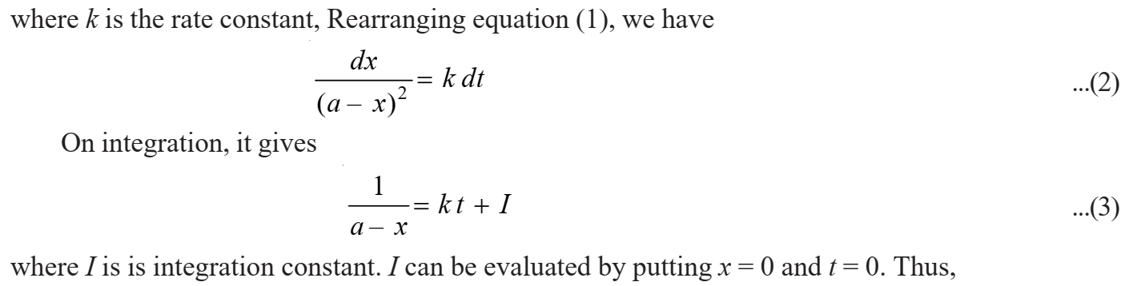

Slide 12
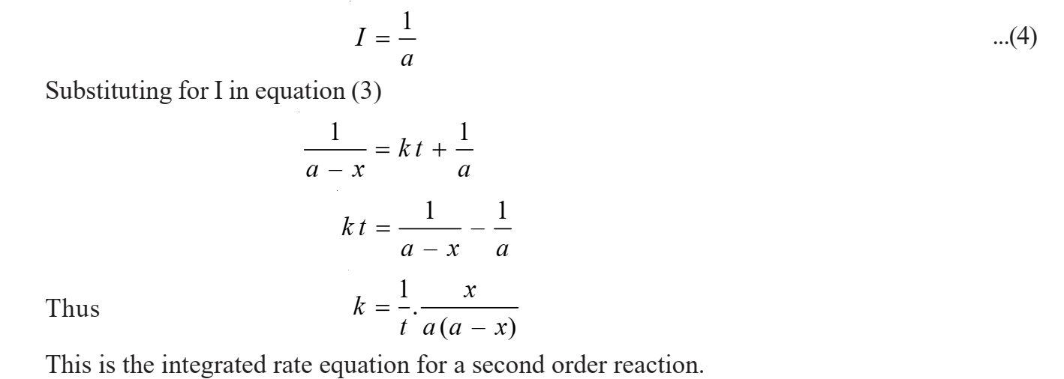

Slide 13
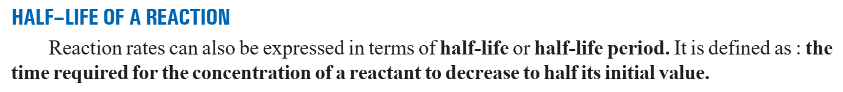
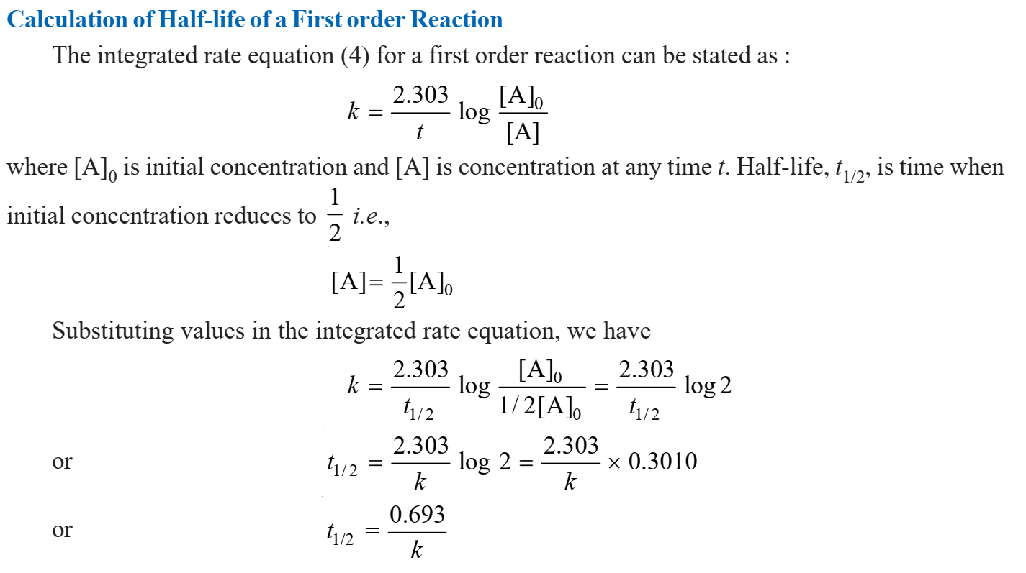
The half-life of a first order reaction does not depend on initial concentration.

Slide 14
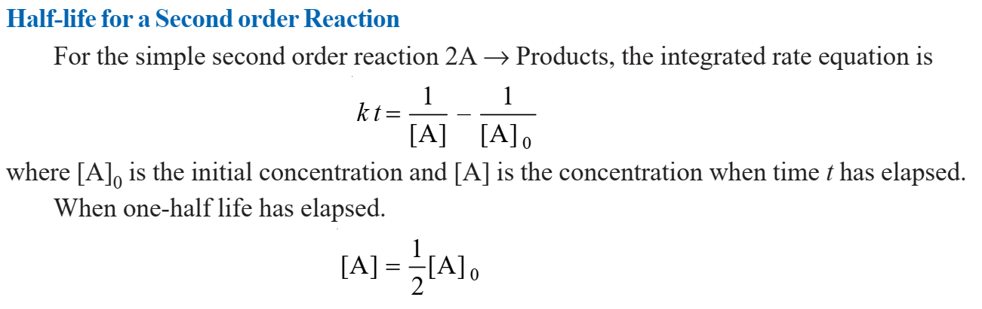
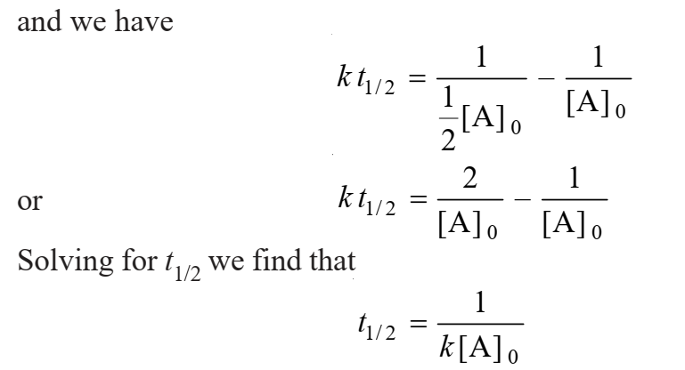
The half-life of a second order reaction depends on initial concentration.

Slide 15
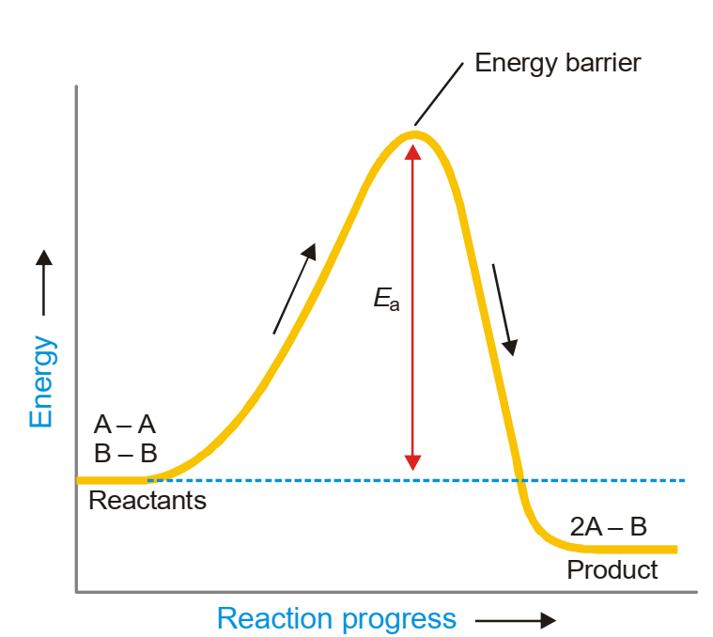
COLLISION THEORY OF REACTION RATES: According to this theory, a chemical reaction takes place only by collisions between the reacting molecules. But not all collisions are effective. Only a small fraction of the collisions produce a reaction.
The two main conditions for a collision between the reacting molecules to be productive are : (1) The colliding molecules must posses sufficient kinetic energy to cause a reaction. (2) The reacting molecules must collide with proper orientation (1) The molecules must collide with sufficient kinetic energy Let us consider a reaction A – A + B – B ⎯⎯→ 2A – B

Slide 16
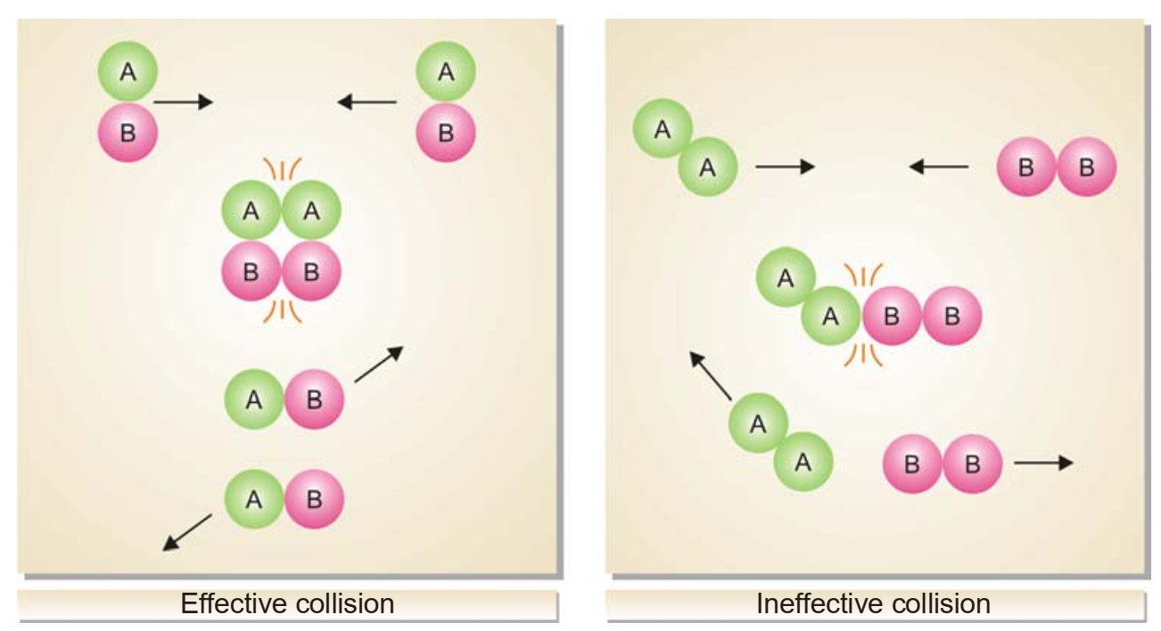
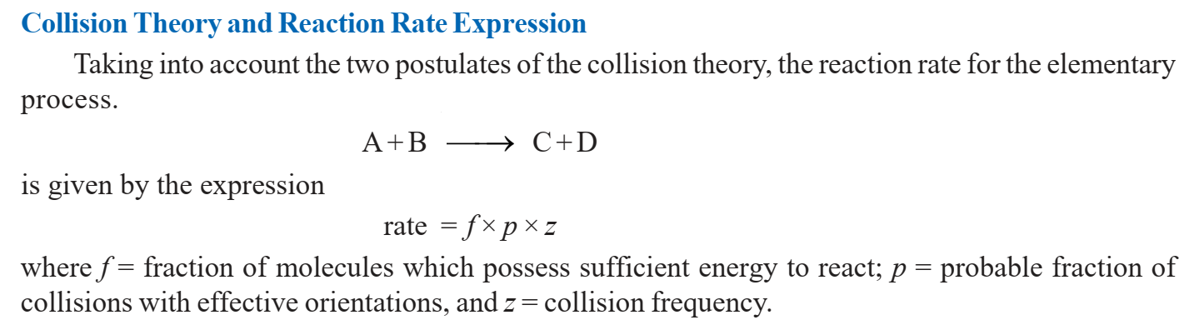
(2) The molecules must collide with correct orientation: The correct orientation is that which ensure direct contact between the atoms involved in the breaking and forming of bonds.

Slide 17
Limitations of the Collision Theory
The theory applies to simple gaseous reactions only.
For reactions involving complex molecules, the experimental rate constants are quite different from the calculated values.
There is no method for determining the steric effect (p) for a reaction whose rate constant has not been determined experimentally.
In the collision theory it is supposed that only the kinetic energy of the colliding molecules contributes to the energy required for surmounting the energy barrier. There is no reason why the rotational and vibrational energies of molecules should be ignored.
The collision theory is silent on the cleavage and formation of bonds involved in the reaction.

Slide 18
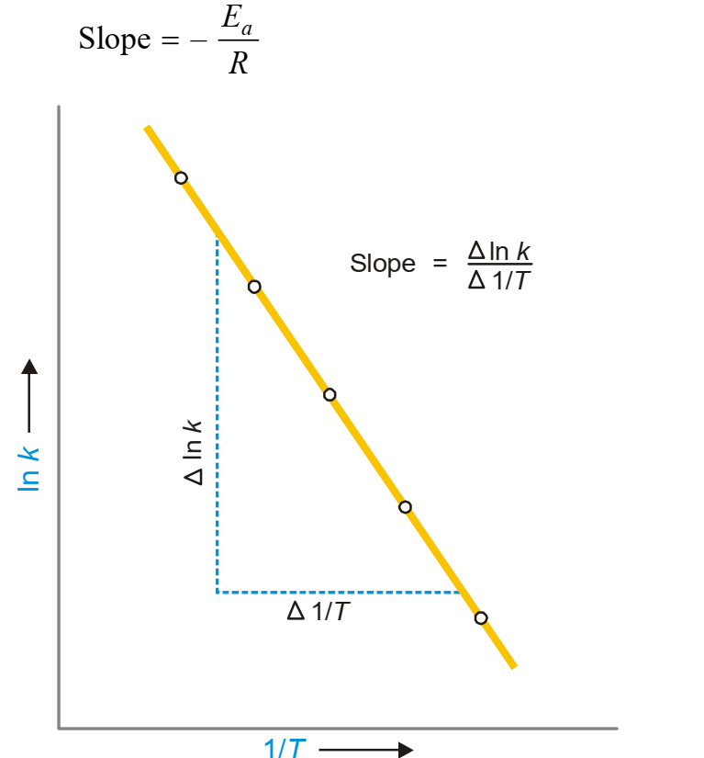

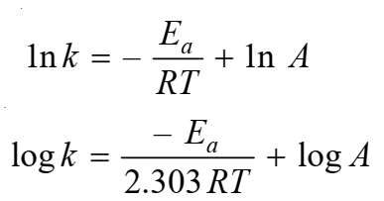
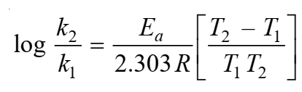
Temperature Dependence of Reaction Rate and Arrhenius Equation: The kinetic energy of a gas is directly proportional to its temperature. Thus as the temperature of a system is increased, more and more molecules will acquire necessary energy greater that Ea to cause productive collisions. This increases the rate of the reaction. In 1889, Arrhenius suggested as simple relationship between the rate constant, k, for a reaction and the temperature of the system.
If k1 and k2 are the values of rate constants at temperatures T1 and T2 respectively, we can derive

Slide 19
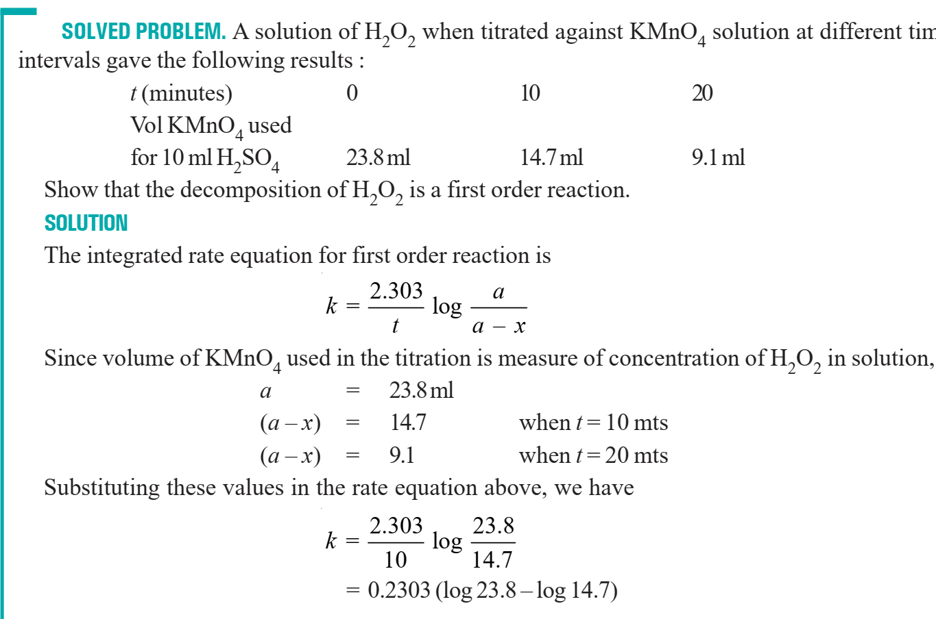

Slide 20
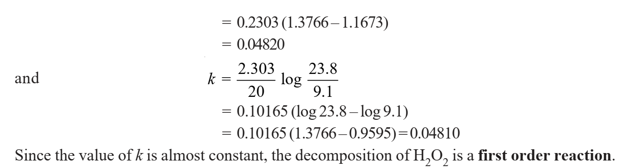

Slide 21
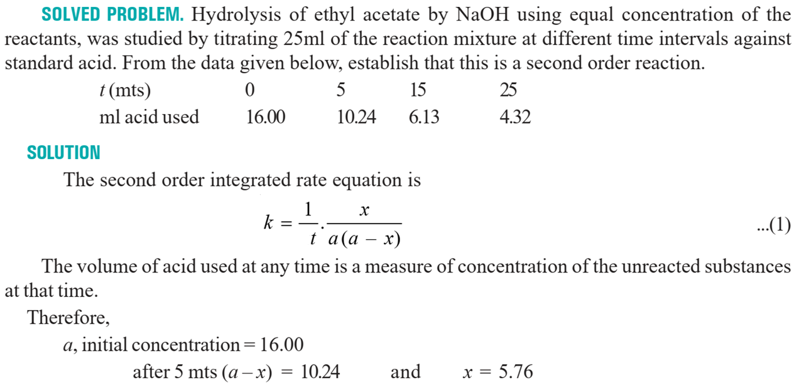

Slide 22
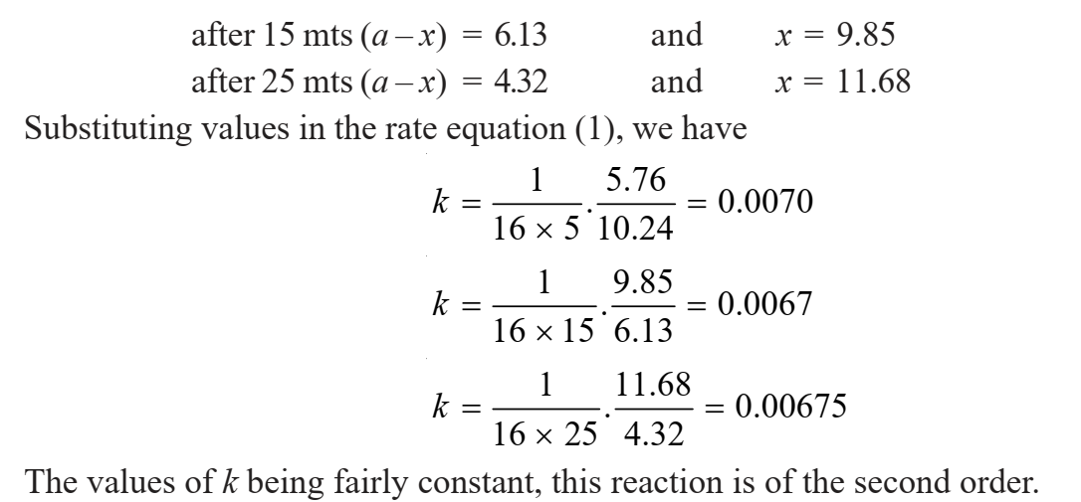

Slide 23
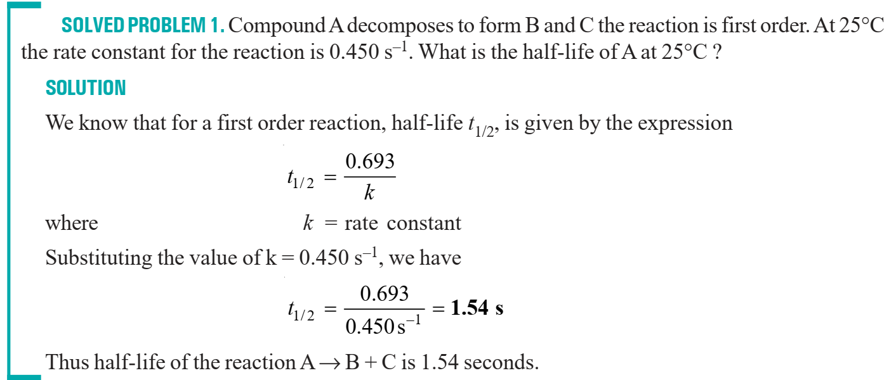

Slide 24
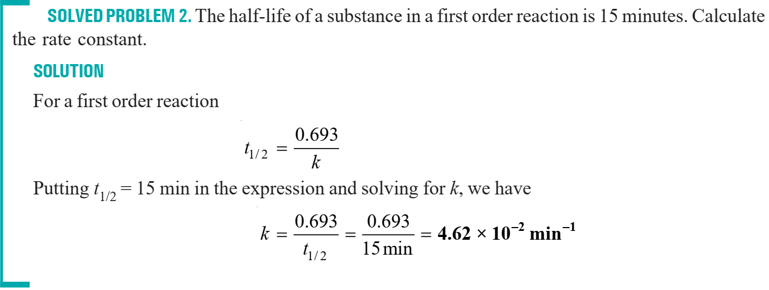

Slide 25
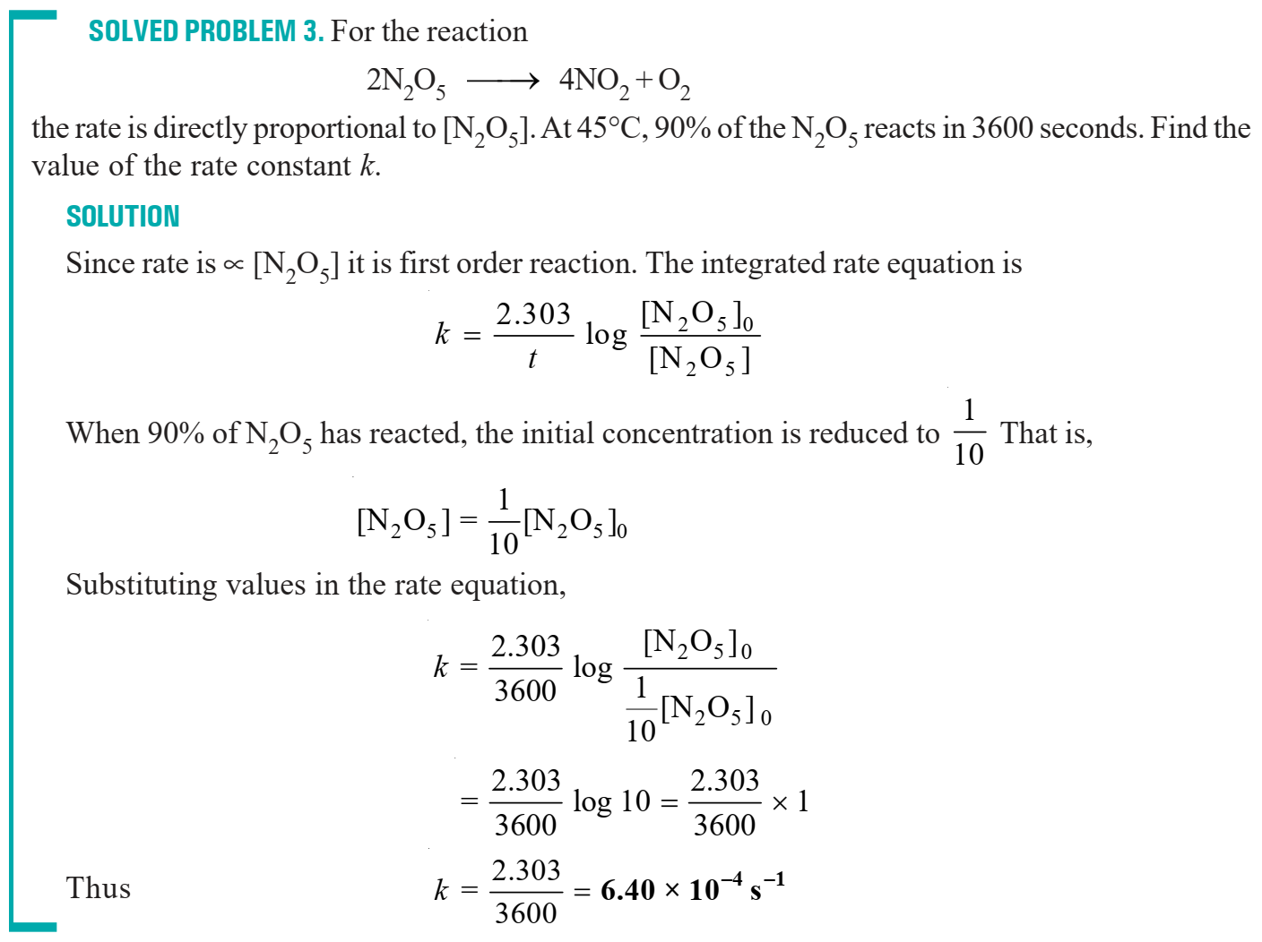

Slide 26
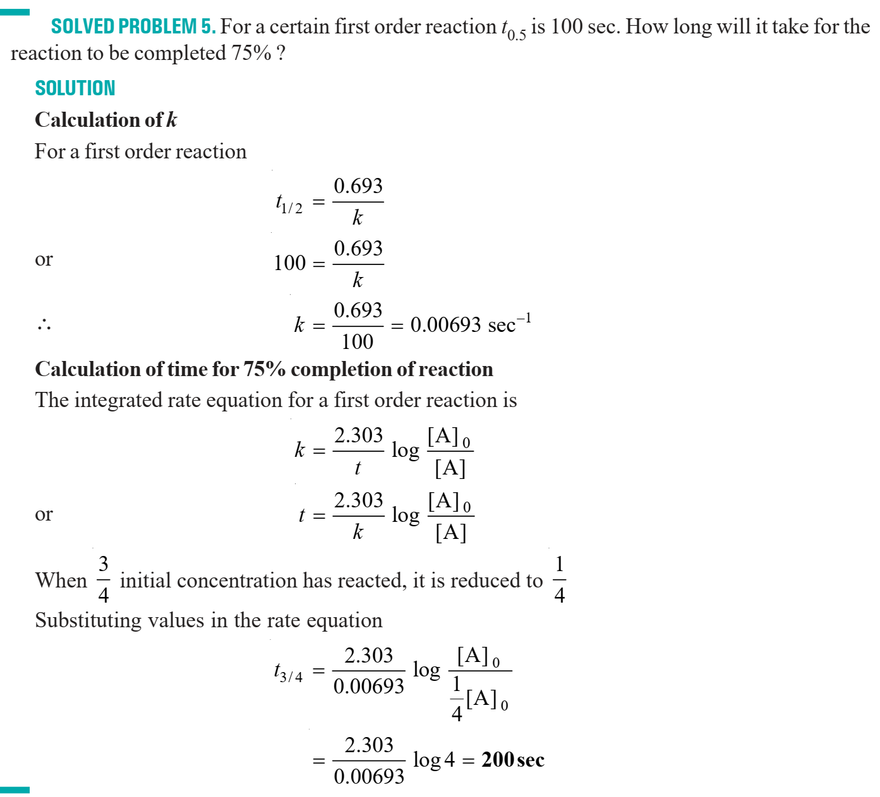

Slide 27
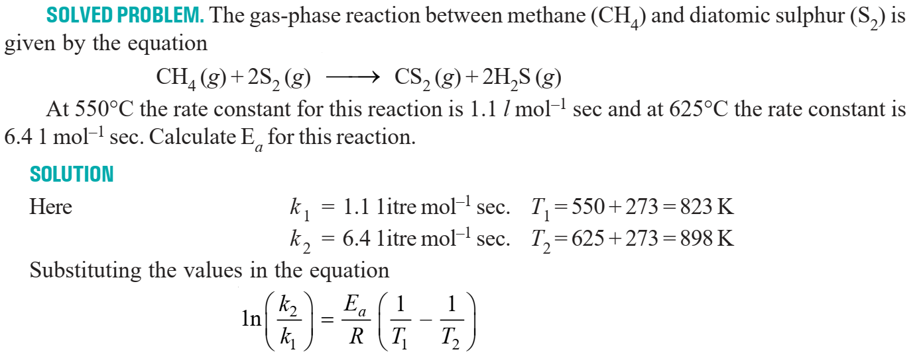

Slide 28
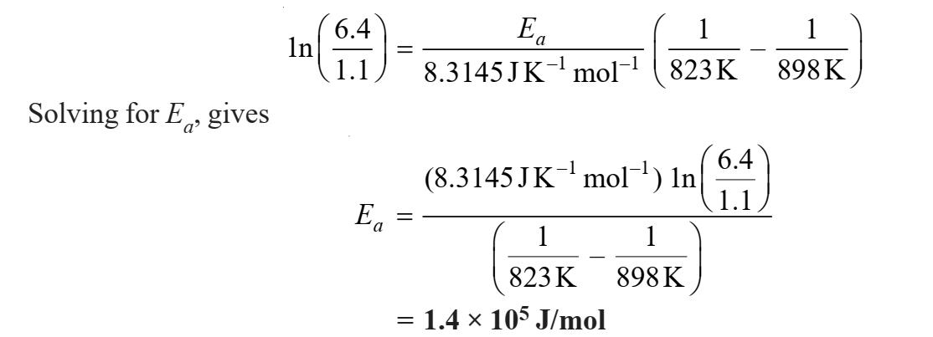

Slide 29
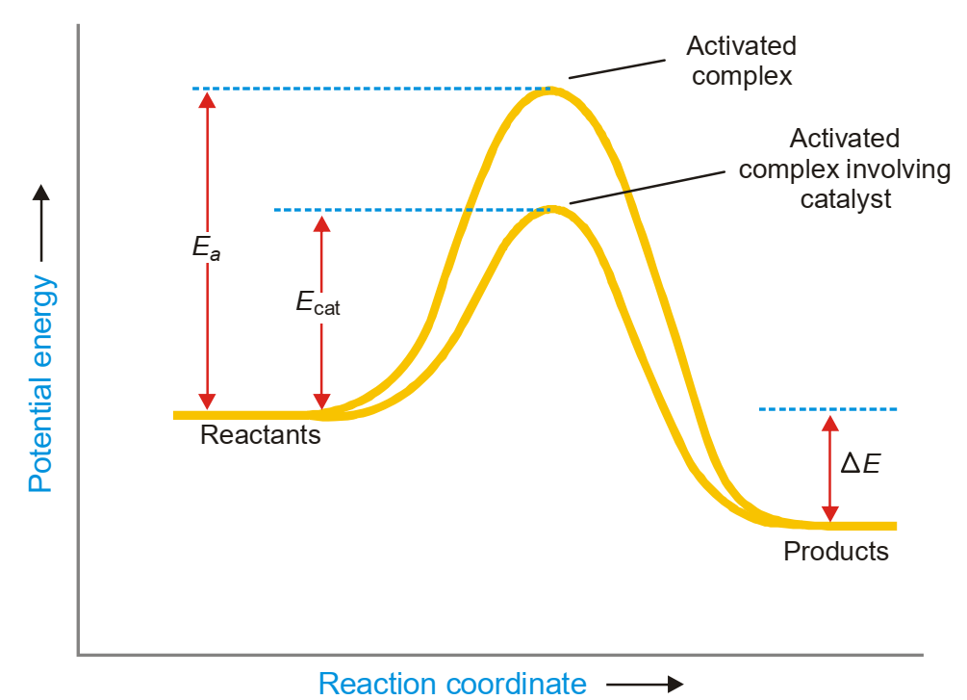
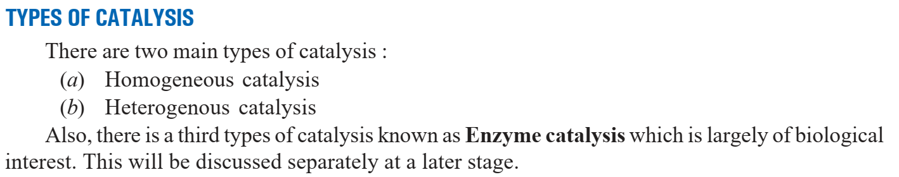
Catalyst: The catalyst which accelerates the reaction rate by providing another pathway with lower activation energy

Slide 30


HOMOGENEOUS CATALYSIS: The catalyst is in the same phase as the reactants and is evenly distributed throughout.
HETEROGENEOUS CATALYSIS: The catalysis in which the catalyst is in a different physical phase from the reactants is termed Heterogeneous catalysis.

